Slide 1
Trend Statistics

Slide 2
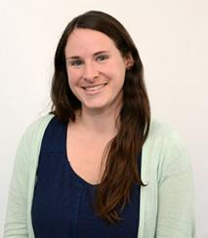



Team
Jennifer Morris (Principal Research Scientist, Center for Sustainability Science and Strategy)
C. Adam Schlosser (Deputy Director, Center for Sustainability Science and Strategy)
Xiang Gao (Principal Research Scientist, Center for Sustainability Science and Strategy)
Kenneth Cox (Research Associate, Center for Sustainability Science and Strategy)

Slide 3
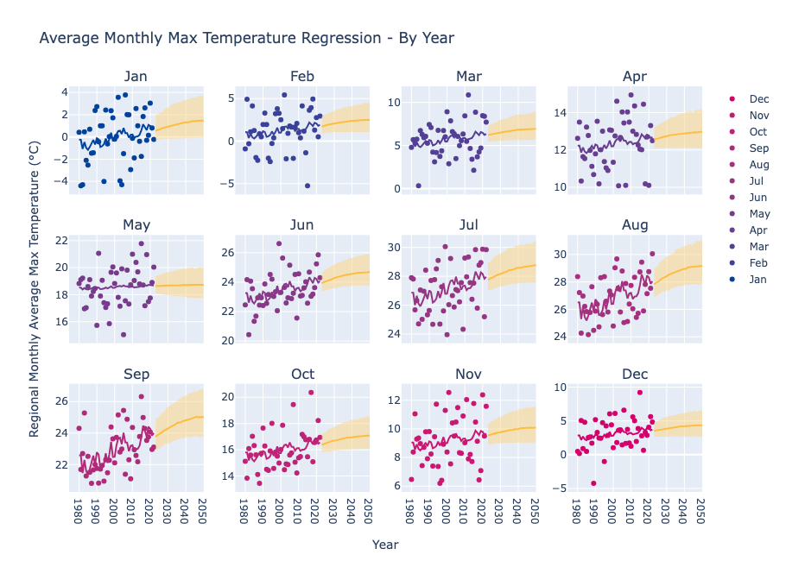
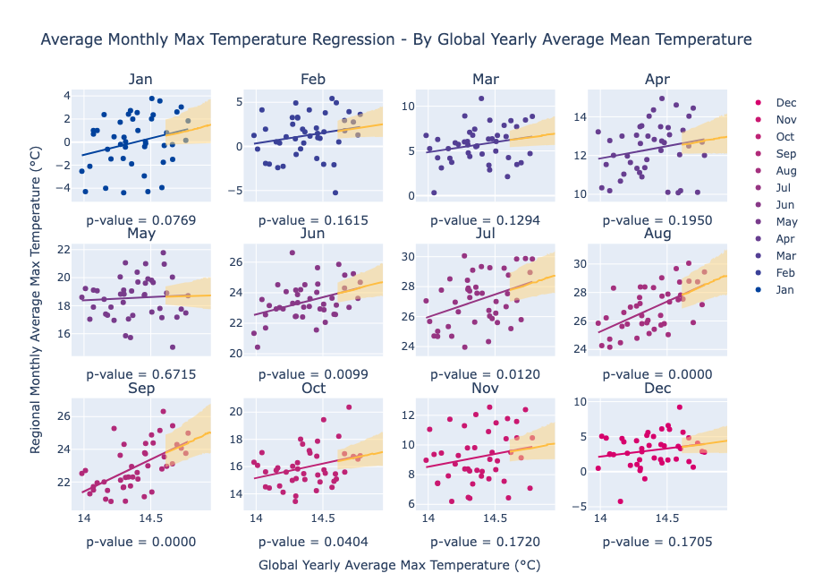
MA Projections – Accelerated Actions

Slide 4
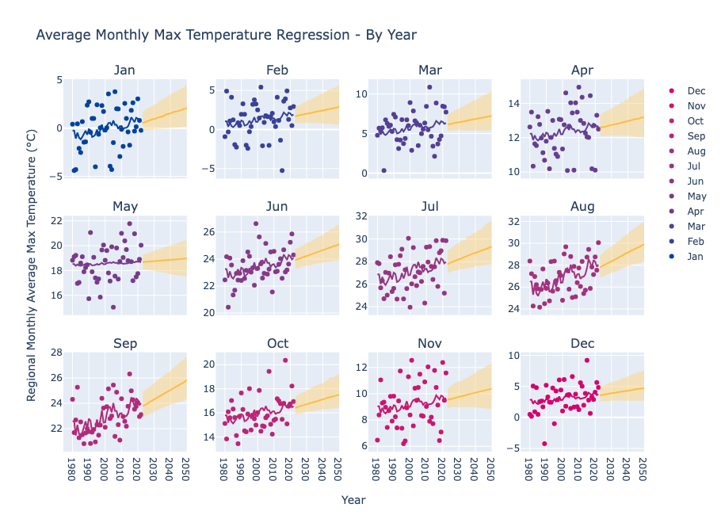
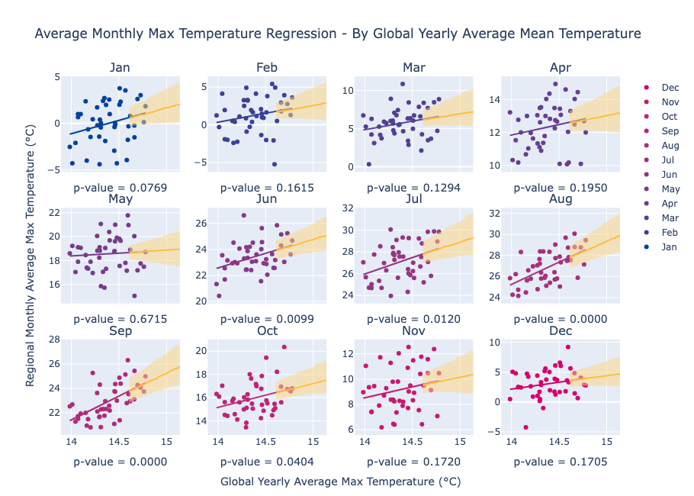
MA Projections – Current Trends

Slide 5
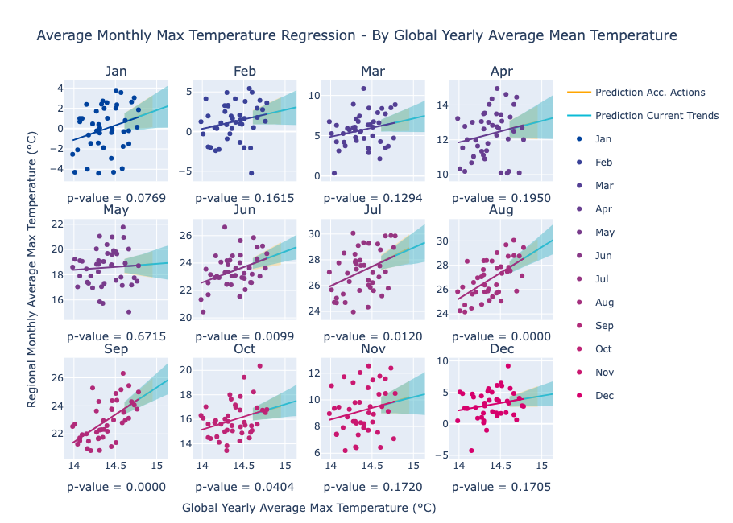
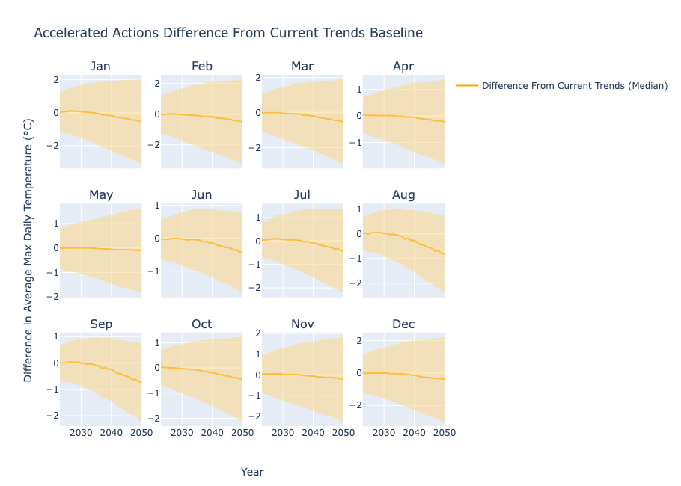
MA Projections – Comparison

Slide 6
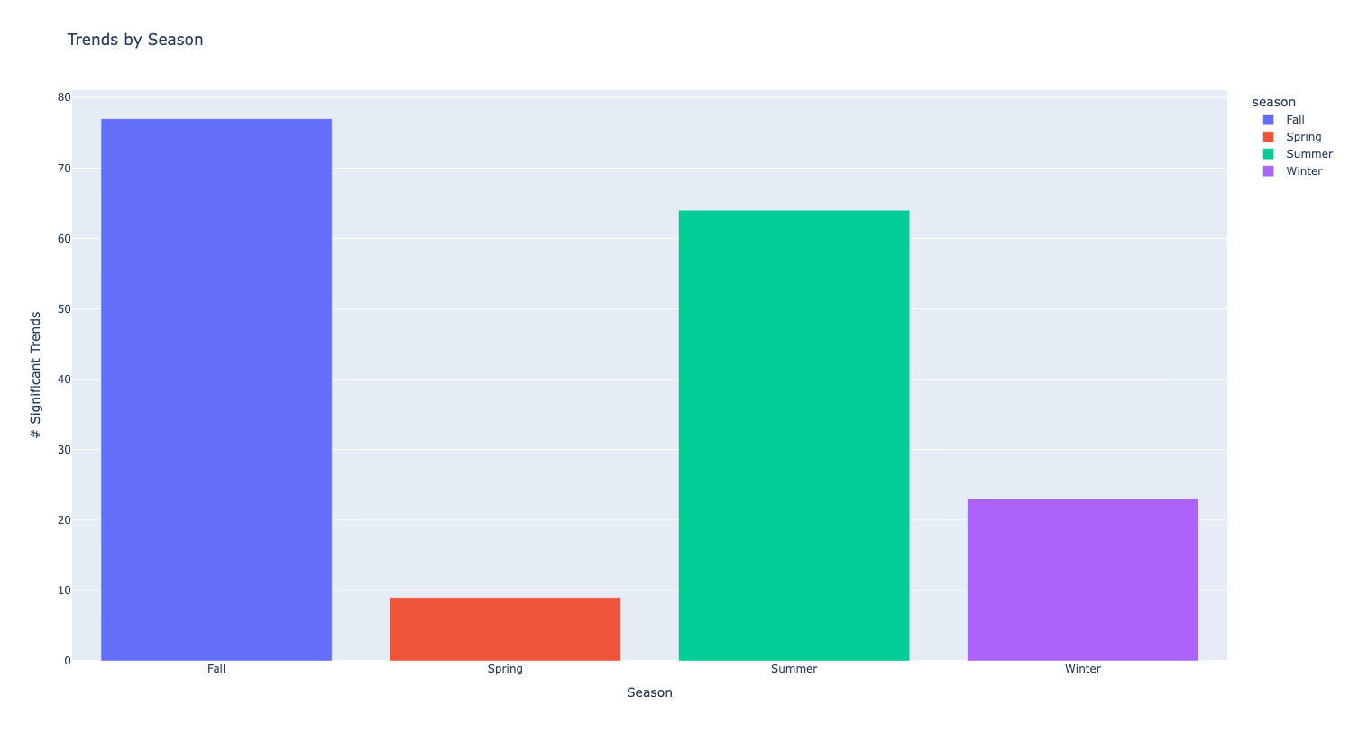
“significant trend” refers to the presence of >70th percentile slope across all regions AND significance at α = 0.05

Slide 7
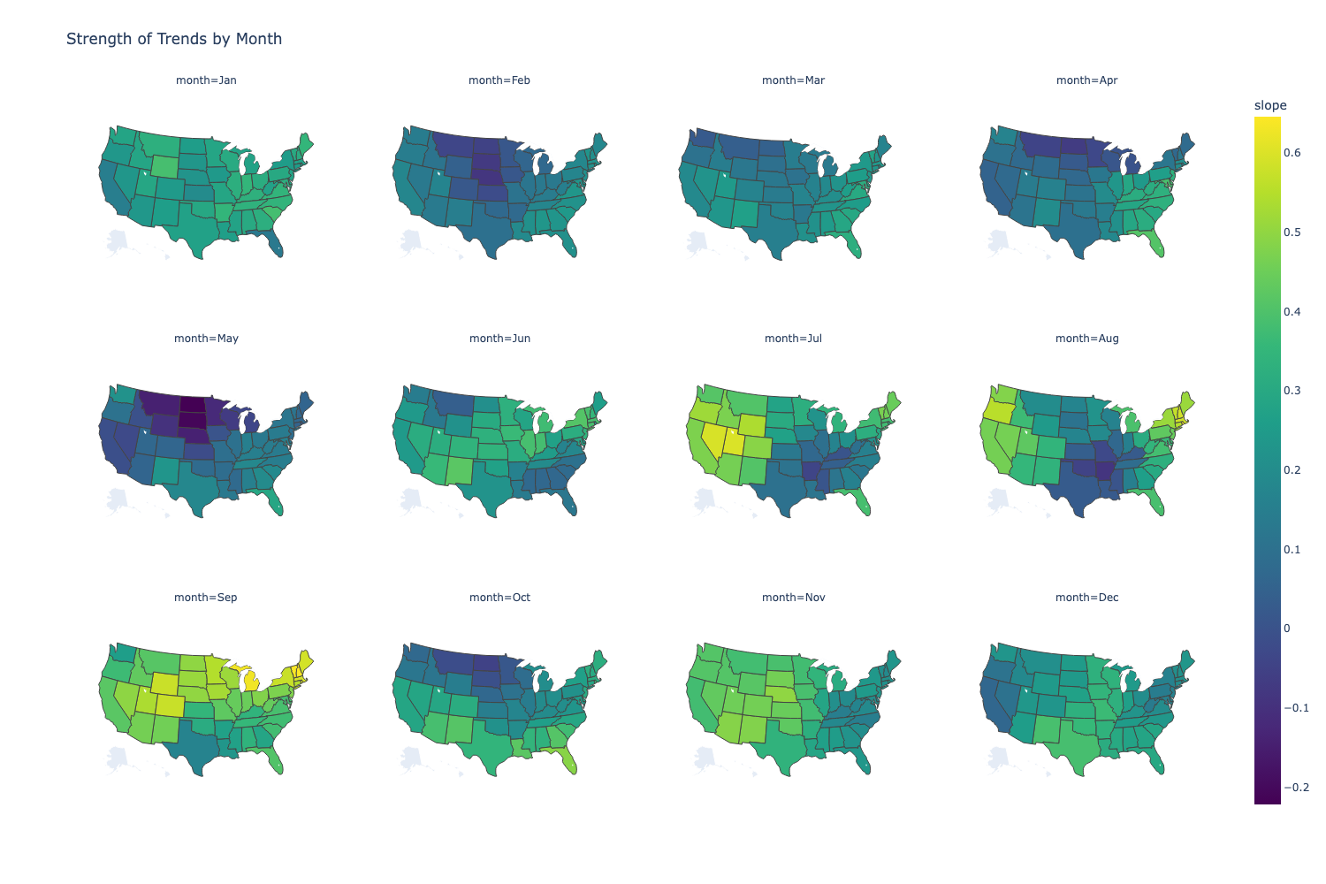

Slide 8
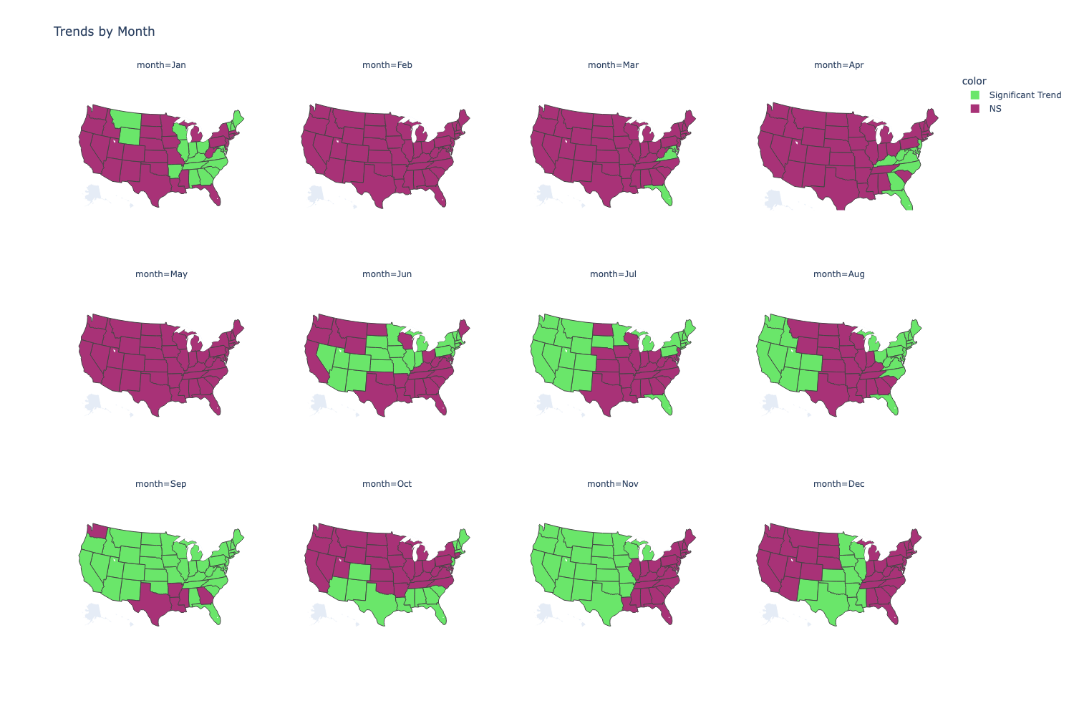
significance assessed with Wald test on slope, α = 0.05, ONLY significance assessed

Slide 9
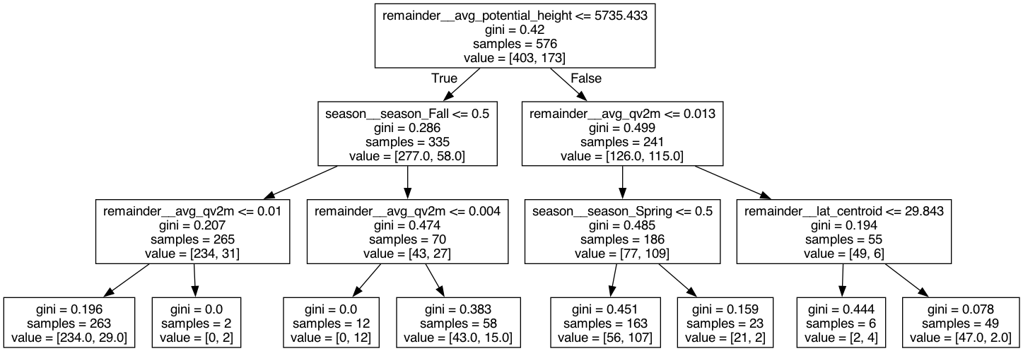
Decision Tree for >70th Percentile Max Daily Temperature
Feature importances from random forest:
1. Baseline temp: 0.17
2. Avg height at 500 hPa: 0.15
3. Avg specific humidity: 0.15
Notes:
Larger heights result in stronger trends -->

Slide 10
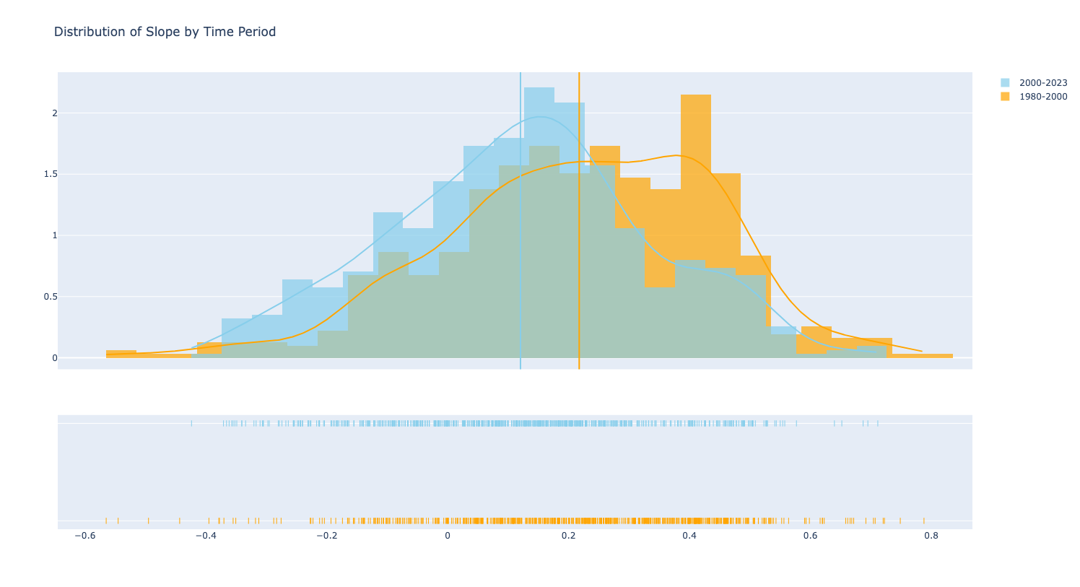

Slide 11
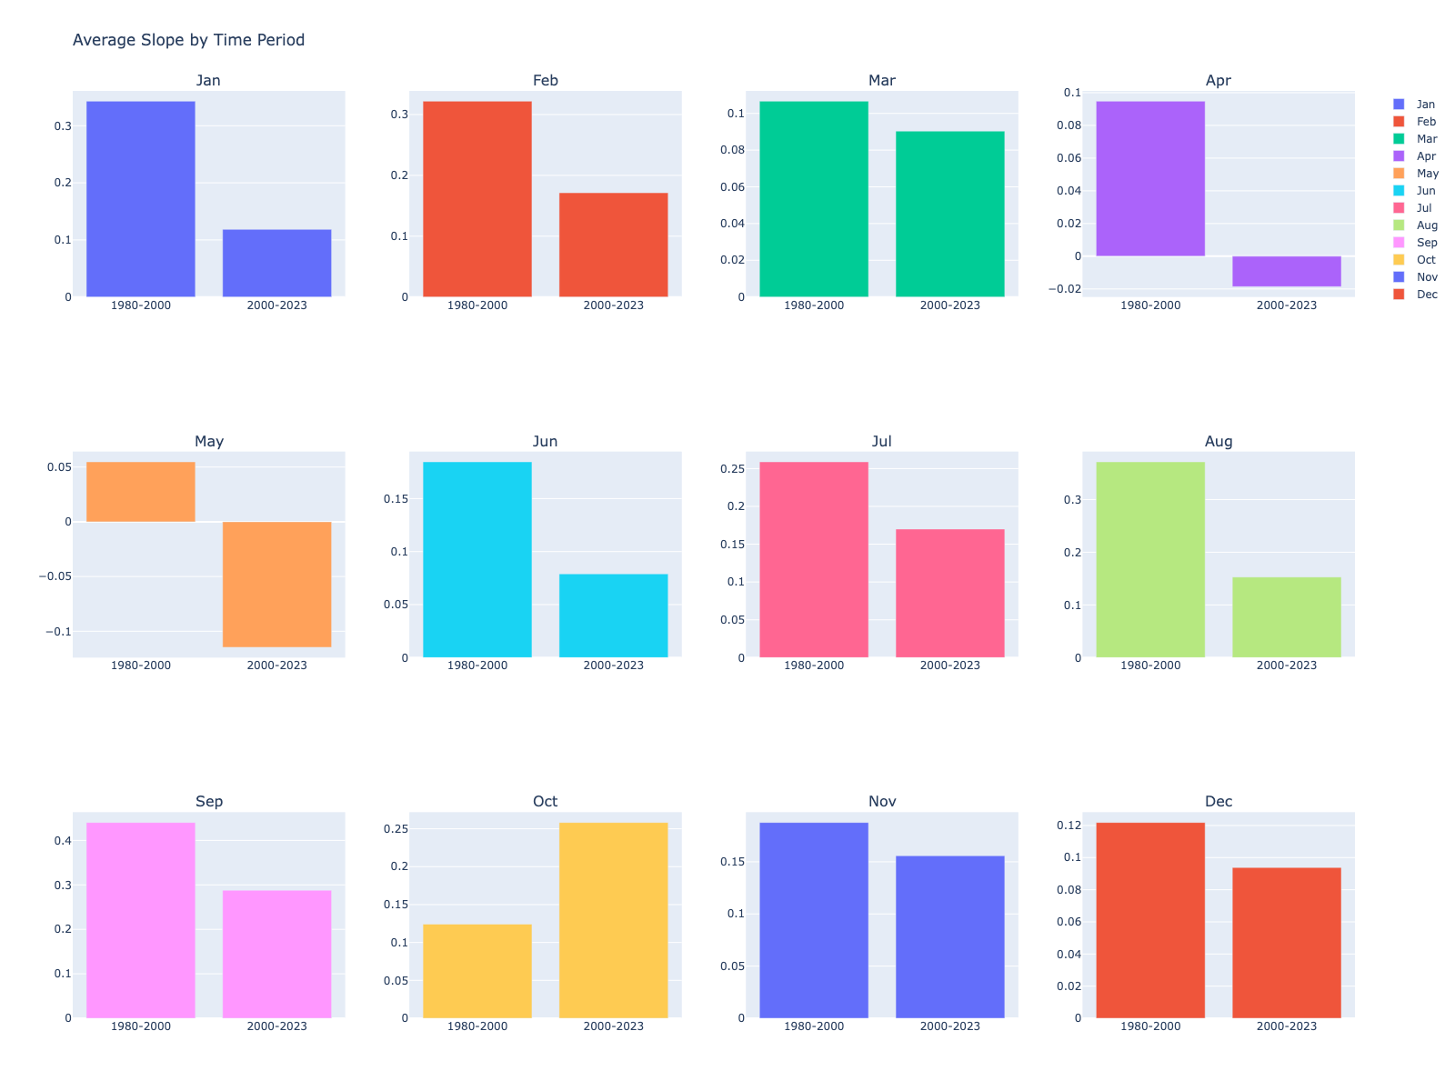

Slide 12
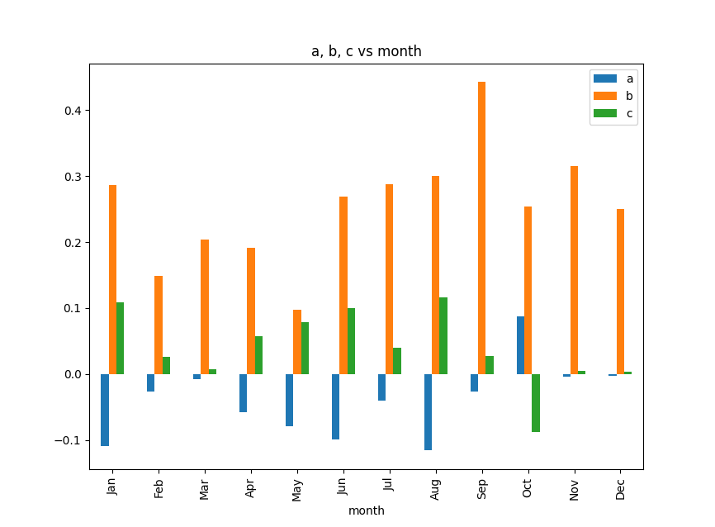
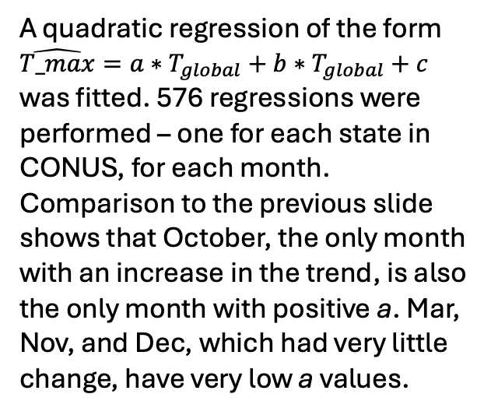
A quadratic regression of the form $\hat{T_max}=a∗T_{global}+b∗T_{global}+c$ was fitted. 576 regressions were performed – one for each state in CONUS, for each month. Comparison to the previous slide shows that October, the only month with an increase in the trend, is also the only month with positive a. Mar, Nov, and Dec, which had very little change, have very low a values.

Slide 13
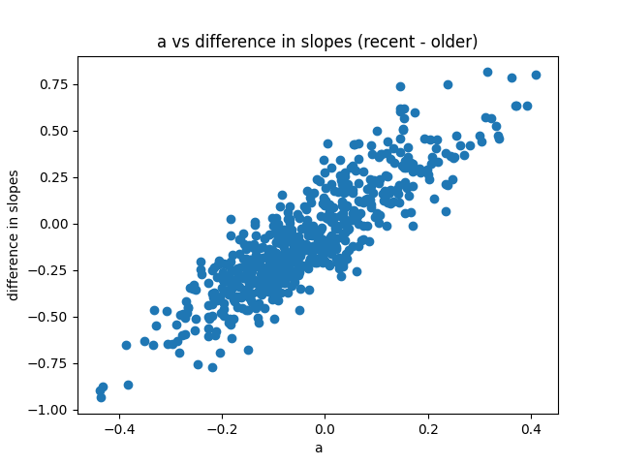

Slide 14
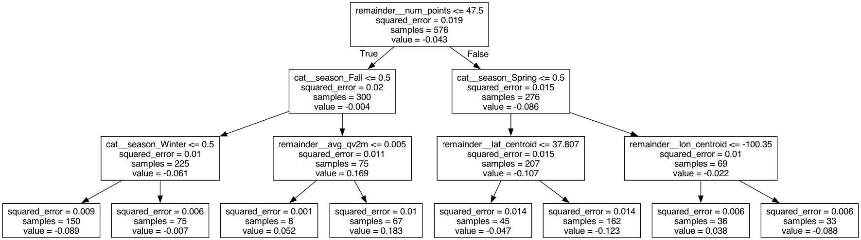
CART Regression Tree for Associations with Leading Term (a)

Slide 15
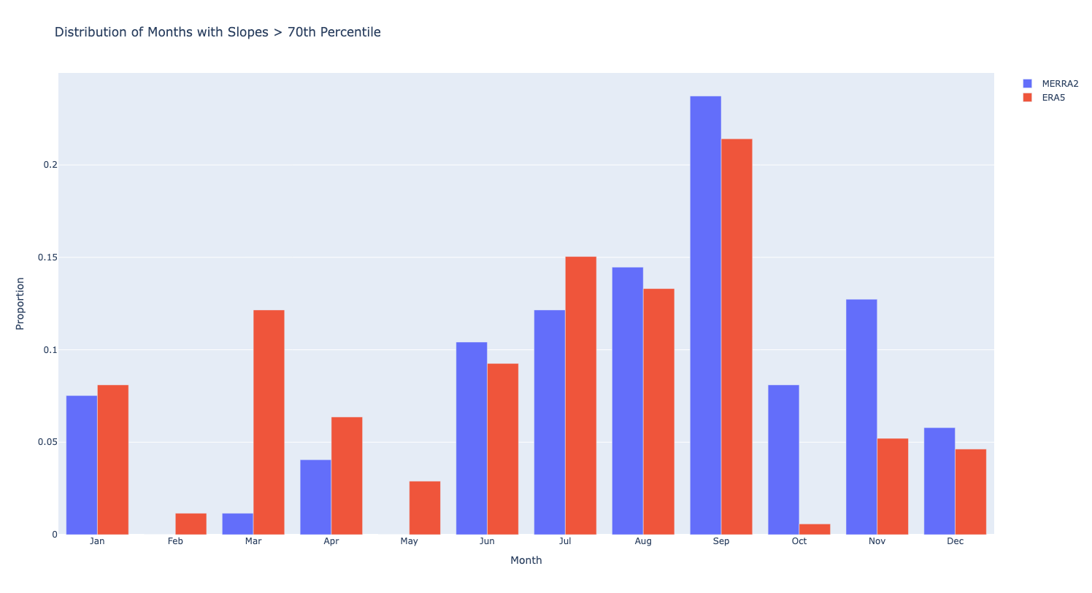
Method of calculation: for each dataset, 70th percentile slope values were computed across all state-month pairs (576). The graph displays the proportion of 70th percentile slopes that lie in a given month. For example, in the ERA5 dataset, about 10% of >70th percentile slopes are contained in July.

Slide 16
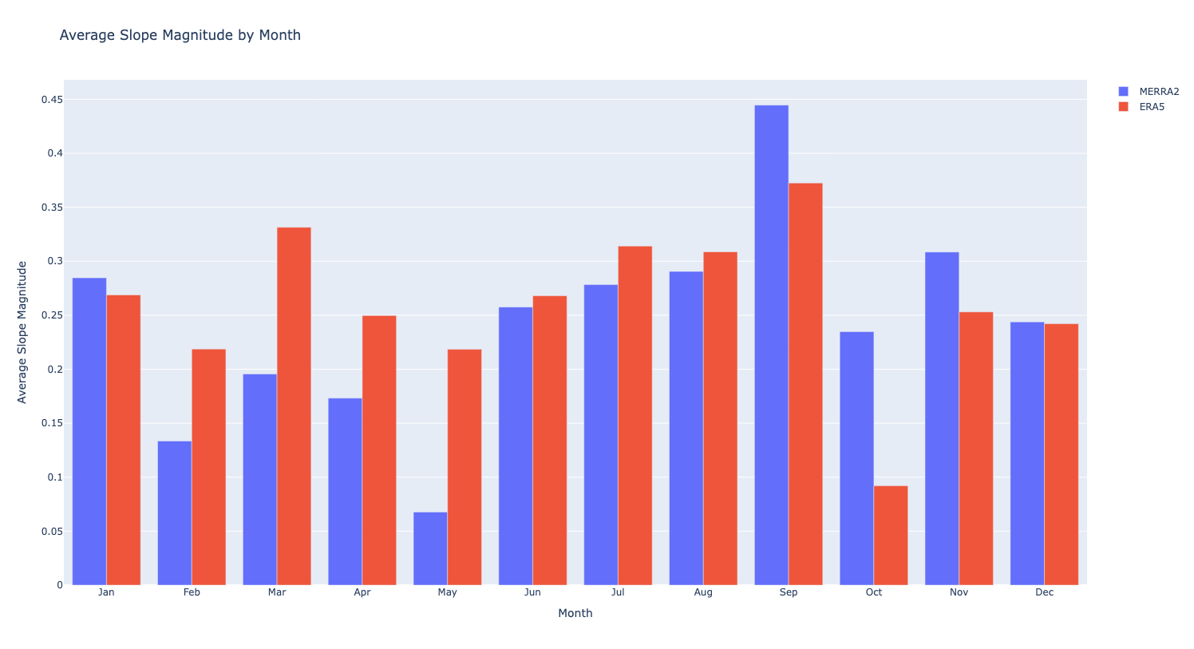
Notes:
Thoughts: we are just computing an average by month, it does not reflect things like the area of the state

Slide 17
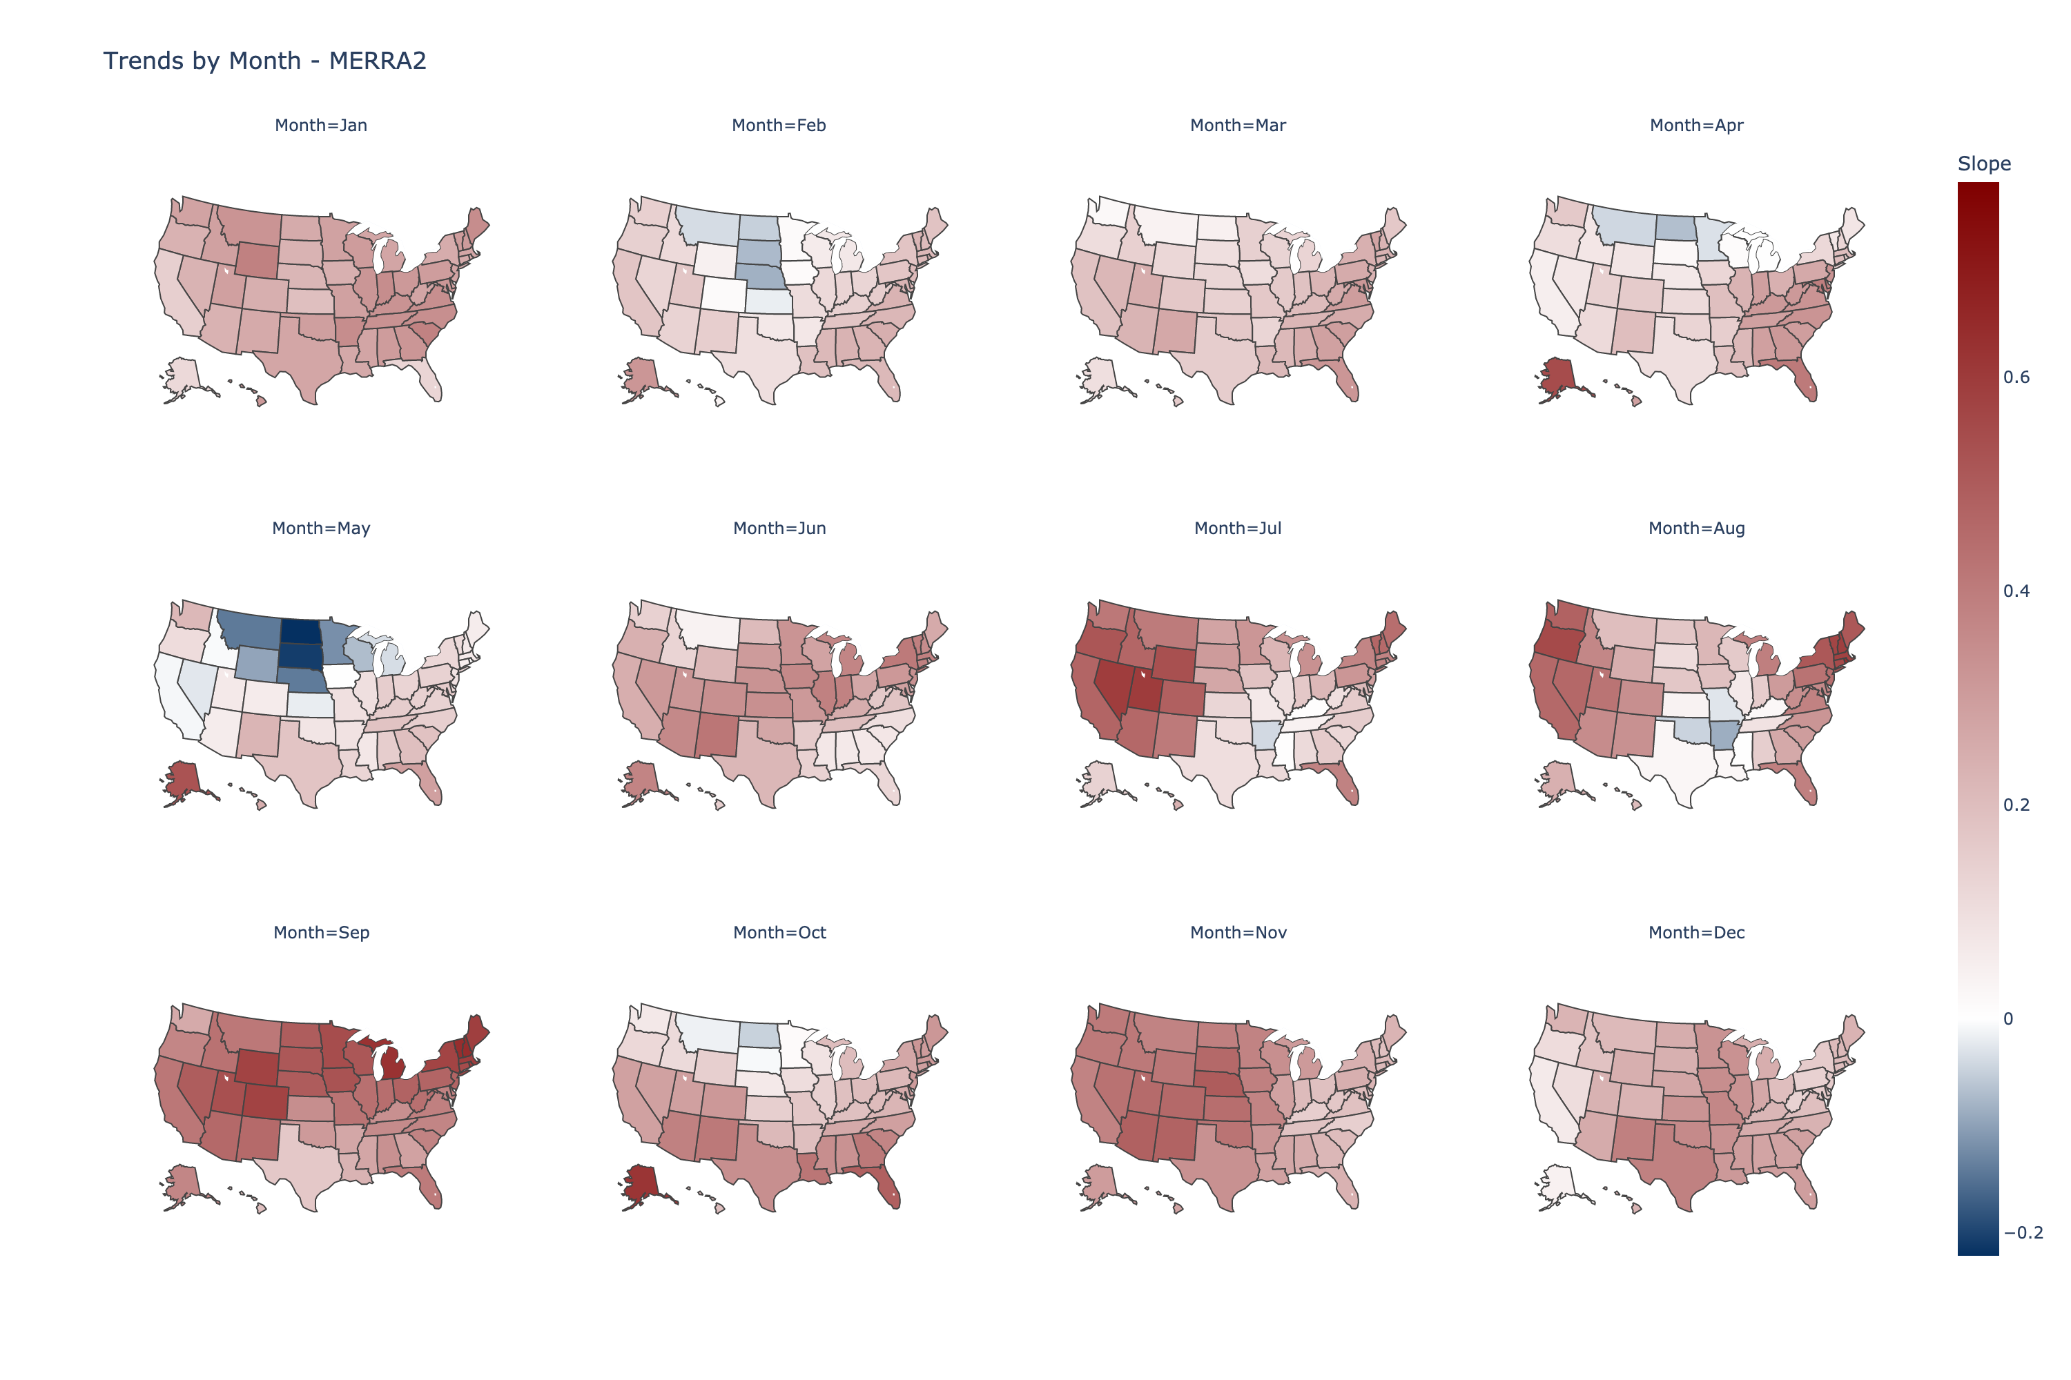

Slide 18
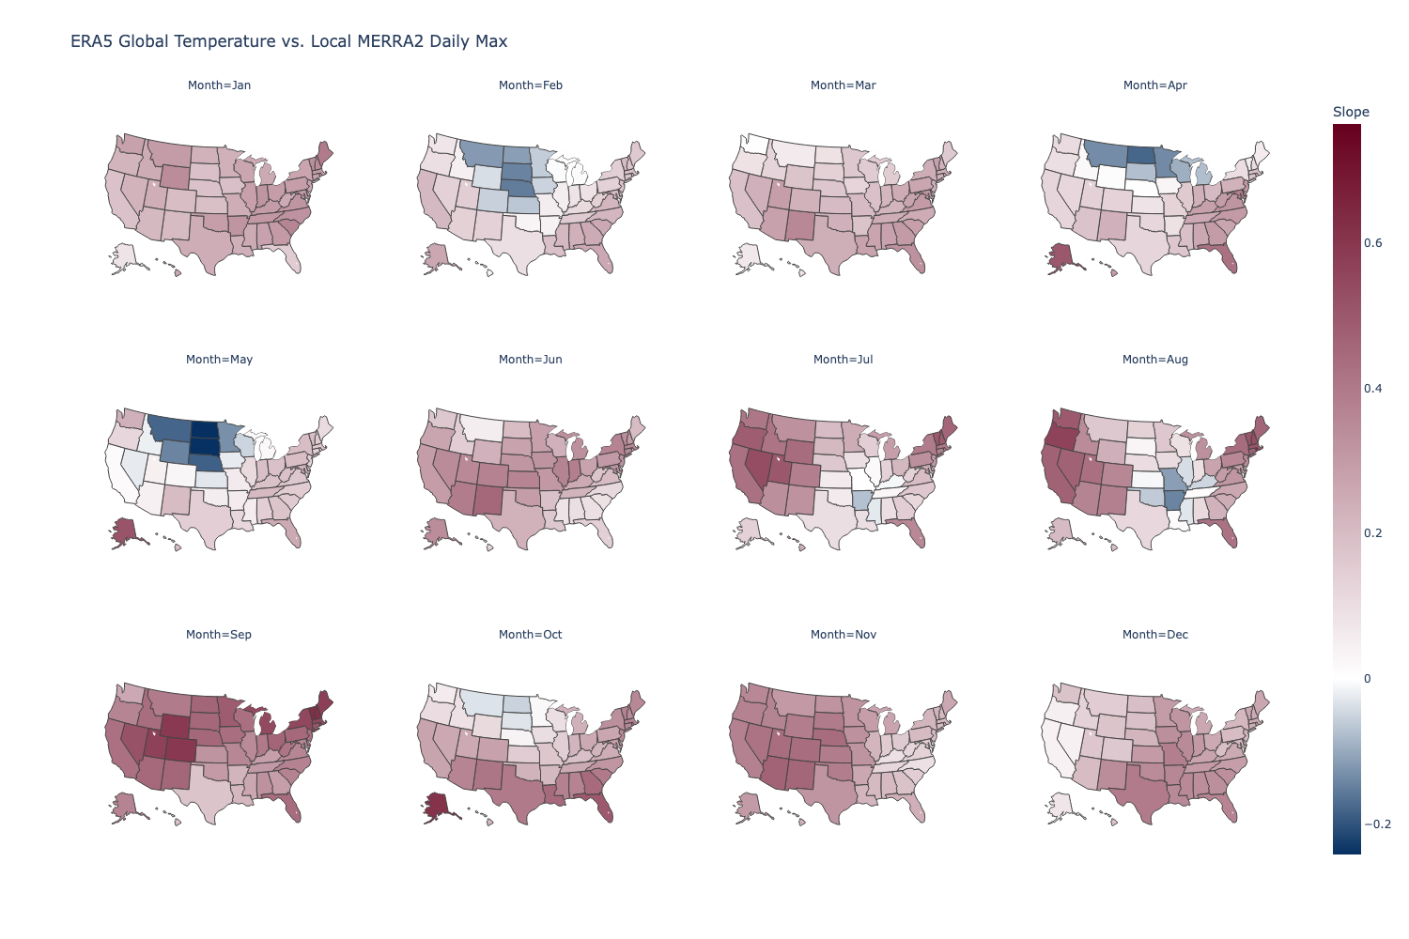

Slide 19
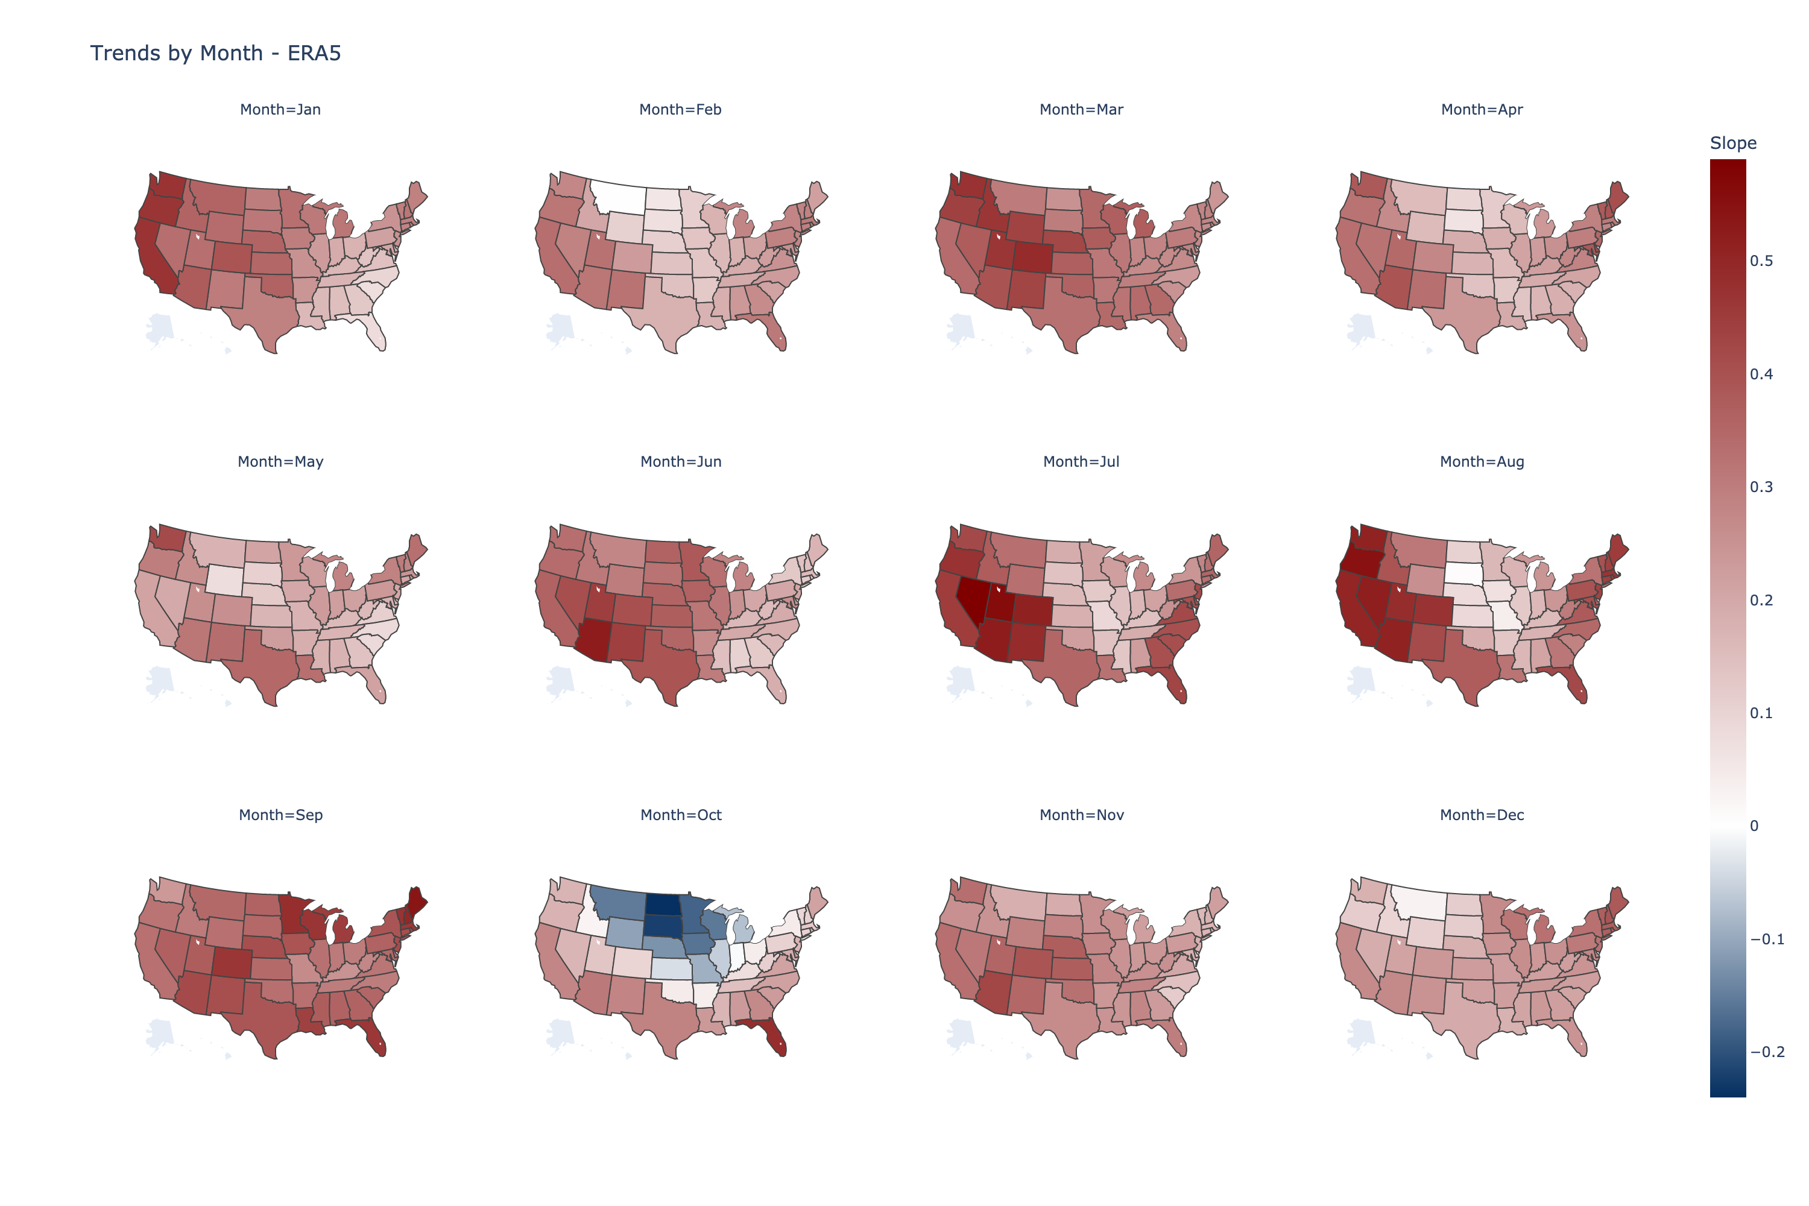

Slide 20
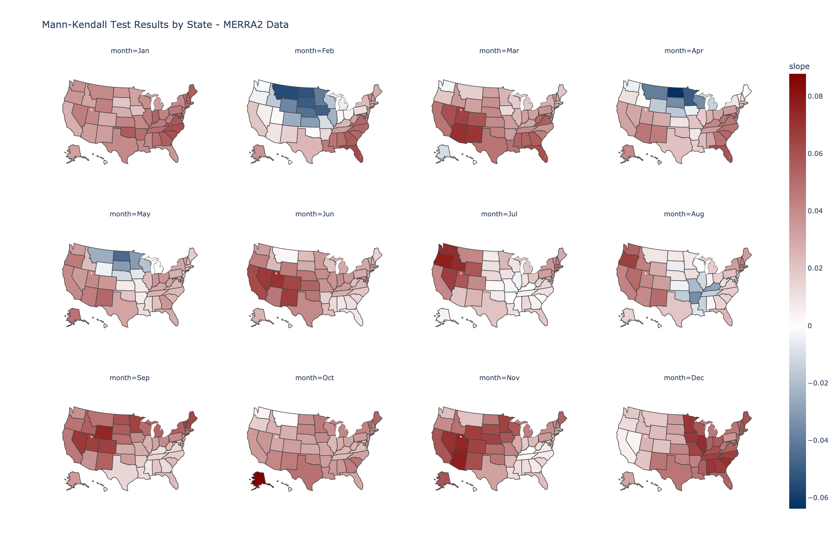

Slide 21
